Slide 1
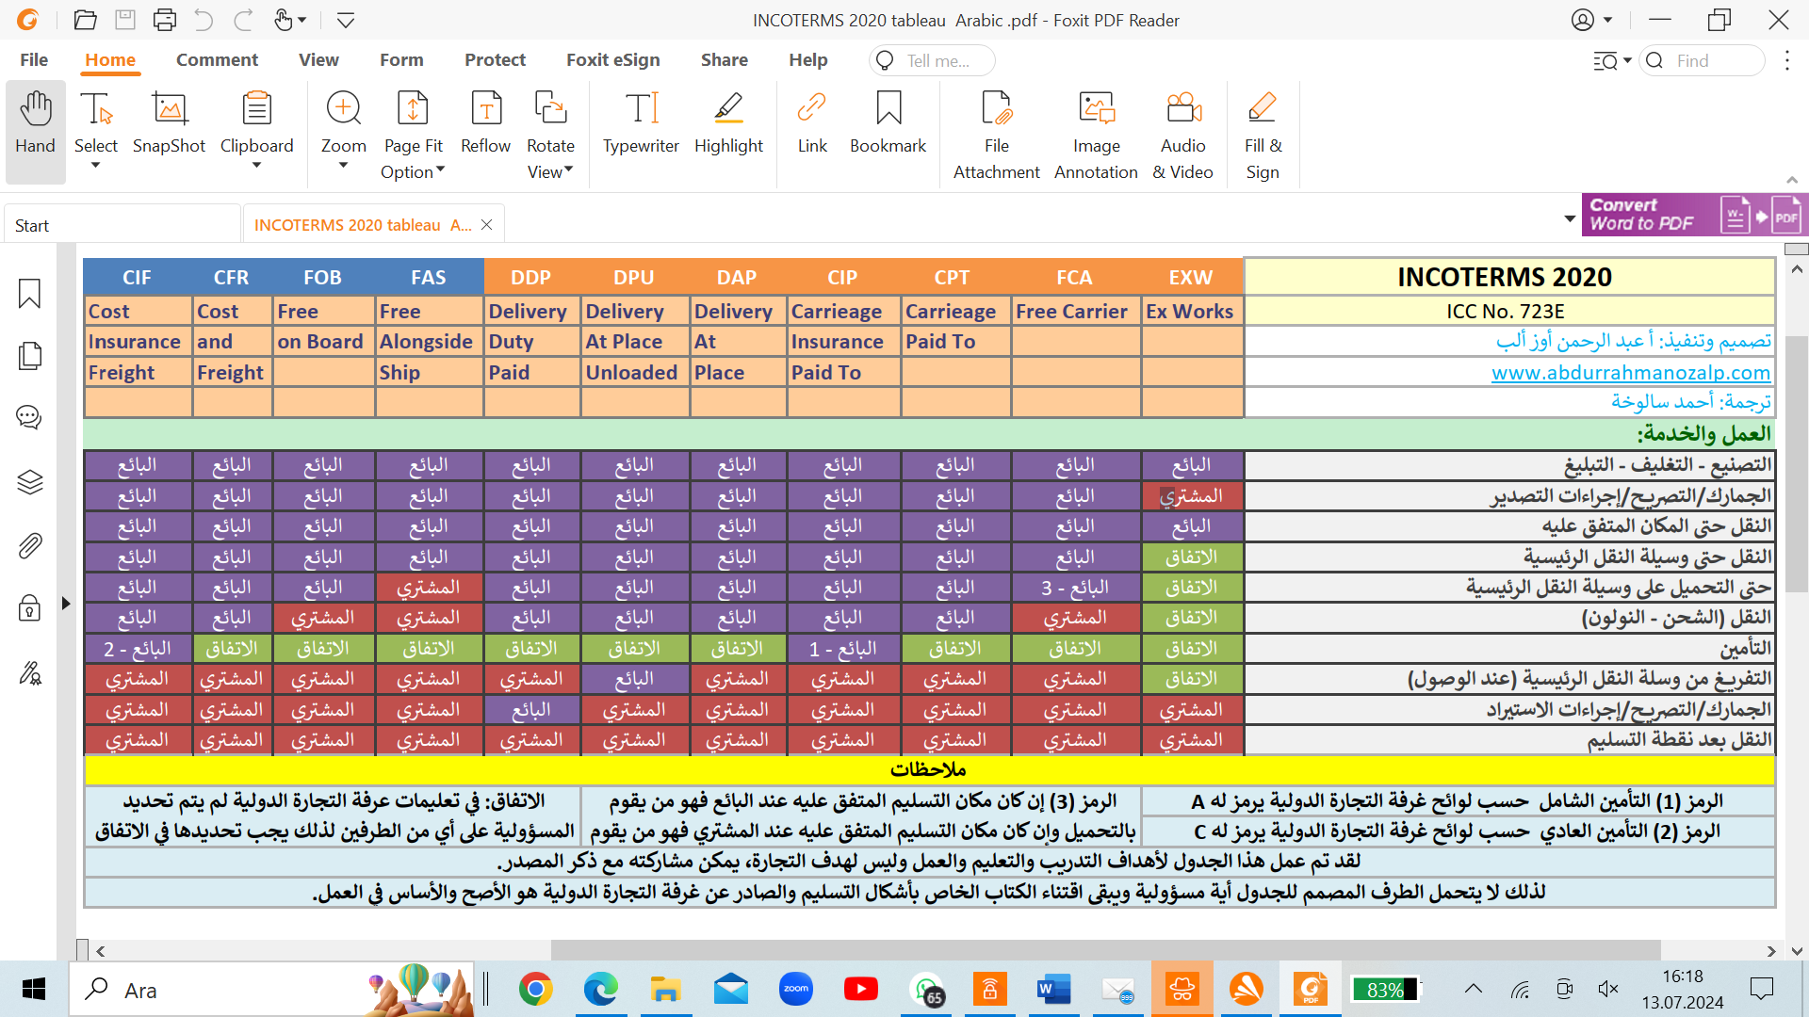
Translated to Arabic by Ahmed Saluha

